Slide 1
APUSH Review: Key Concept 4.3 (Revised, 2015 Edition)
Everything You Need to Know About Key Concept 4.3 To Succeed In APUSH

Slide 2
Key Concept 4.3
“The U.S. interest in increasing foreign trade and expanding its national borders shaped the nation’s foreign policy and spurred government and private initiatives.”
Page 50
Big Idea Questions:
What was the message of, and impact, of the Monroe Doctrine?
How did westward expansion lead to conflicts over slavery?

Slide 3
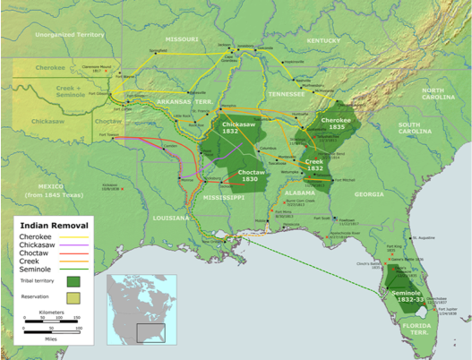
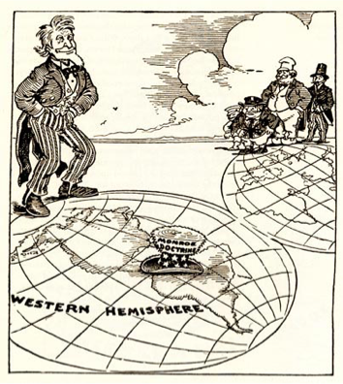
Key Concept 4.3, I
“Struggling to create an independent global presence, the United States sought to claim territory throughout the North American continent and promote foreign trade.” pf. 50
A) Post-LA Purchase, US sought to increase influence through:
Exploration: Lewis and Clark
Sought to find a waterway to the Pacific
Gained immense knowledge about the environment and Natives
Military Actions:
“Aroostock War” - settled ME-Canada boundary
American Indian Removal:
Indian Removal Act -> Trail of Tears - Moved Natives west of MS River
Diplomatic Efforts
Monroe Doctrine:
Warned Europe to stay out of the Western Hemisphere
In return, the US would stay out of European affairs

Slide 4
Key Concept 4.3, I
B) Those living on the frontier tended to favor expansion:
More land available for farming
Resistance by Native Americans:
Black Hawk War (IL) - 1832:
Native Americans sought to gain land ceded from 1804 back
Seminole Wars (series of wars in early-mid 19th century)
1st - Seminole Natives in FL were forced to move to Central Florida
2nd - Federal government sought to remove Seminoles from Florida

Slide 5
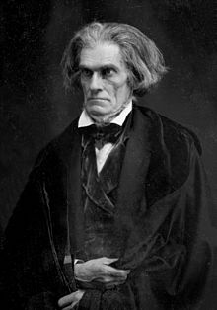
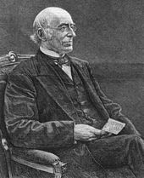
Key Concept 4.3, II
“The United States’ acquisition of lands in the West gave rise to contests over the extension of slavery into new territories.” pg. 51
A) Spread of plantation slavery west of Appalachians:
Deep South - “Cotton Belt” - MS, AL, LA
Many slaveholders moved to more fertile land (cotton, like tobacco exhausted land)
B) Antislavery efforts increased in the North:
Women’s Rights and Abolitionism were closely linked
Lydia Maria Child - abolitionist and women’s rights advocate
William Lloyd Garrison’s The Liberator (1831)- called for immediate and uncompensated end to slavery
Slavery in the South:
3/4 did NOT own slaves
Slavery was defended by Southern leaders and writers:
George Fitzhugh and John C. Calhoun

Slide 6
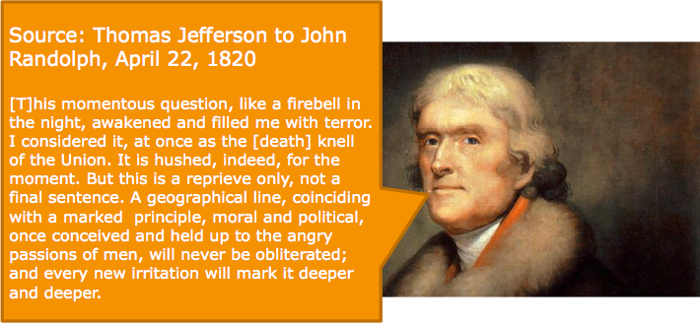
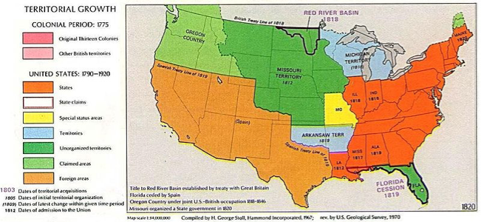
Key Concept 4.3, II
C) Missouri Compromise (Compromise of 1820):
3 parts:
MO would enter the country as a slave state
ME would enter the country as a free state
36°60’ - above free, below slave in LA Purchase
Impact:
Tensions still existed, temporary solution between defenders and supporters of slavery
In the 1850s tensions would come to the forefront

Slide 7
Test Tips
Multiple-Choice and Short Answer:
Examples of US seeking dominance of North America and Western Hemisphere (Monroe Doctrine)
Conflicts with Native Americans
Missouri Compromise
Essay Questions:
Impacts of westward expansion on:
Natives
Tensions between the North and South

Slide 8
See You Back Here For 5.1!
Thanks for watching
Good luck in May!

